Slide 1
Object Detection and Recognition II
D E P A R T M E N T O F C O M P U T E R S C I E N C E U N I V E R S I T Y O F C O P E N H A G E N
Kim Steenstrup Pedersen
Notes:
Forelæsning: 21 (2014)

Slide 2
Plan for today
Dense feature template approaches:
Histogram of Oriented Gradients (HoG)
Deformable parts models (DPM)
Exercise class: Work on Assignment 2

Slide 3
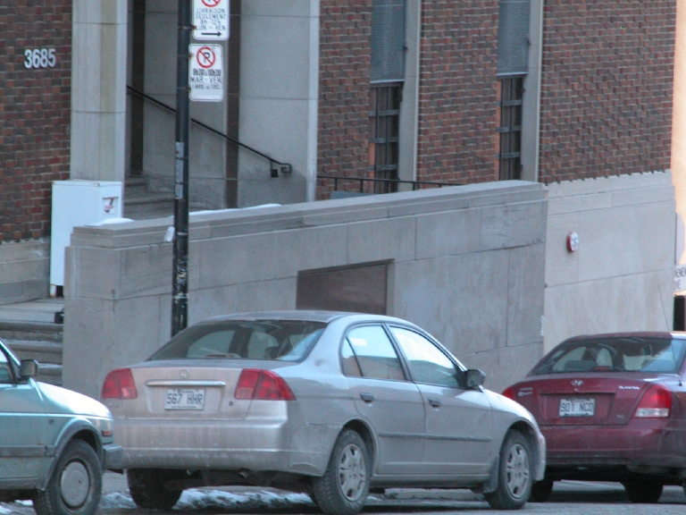
Object detection and recognition
What is in this image?
Where?
Object orientation?
Object extend?
Cars
Window
Lamp post
Notes:
Remember:
Recognition – is there at least one instance present? Resembles CBIR
Detection – how many and where?

Slide 4
Dense feature template approaches
Notes:
Last lecture we looked at interest point based approaches - here is another approach …

Slide 5
Dense feature template approaches
Training:
Extract features on object examples
Train one or more classifiers to discriminate between object categories and background category
Query image:
Apply the classifier to a detection window
Slide the detection window across the image at all positions and scales
Reduce nearby matches to avoid double detections (non-maxima suppression)
Notes:
TODO: Illustrate the sliding window
Draw on board

Slide 6
Example: Detecting people / pedestrians
Notes:
Detecting people or more precisely pedestrians.
Not handling any human pose, but pedestrian type poses (people walking or standing upright).

Slide 7
Object detection using Histograms of Oriented Gradients (HoG) features (Dalal & Triggs’05)
Using the sliding detection window approach
Normalization of image prior to detection:
Use all RGB channels
Optional: Apply power law gamma correction to each channel
Compute gradient image pyramid:
Notes:
Similar in spirit to SIFT, but dense instead of sparse interest points
Gamma correction: Normalize for differences in camera light response functions.
Gamma correction does not have that big an effect.
Gradients: Not using Gaussian derivatives

Slide 8
Recall: The Gaussian pyramid
Notes:
This is simply an implementation of scale space taking advantage of the reduction in detail

Slide 9
Object detection using Histograms of Oriented Gradients (HoG) features (Dalal & Triggs’05)
Using the sliding detection window approach
Normalization of image prior to detection:
Use all RGB channels
Optional: Apply power law gamma correction to each channel
Compute gradient image pyramid:
For each color channel, compute intensity gradients
For each pixel, pick the gradient from the color channel with largest gradient magnitude (simple color gradient)
Detail: Dalal & Triggs do not pre-smooth the image and use the derivative approximation filter
Notes:
Gradients: Not using Gaussian derivatives
Training: Done at fixed scale
Testing: Done at all levels in the pyramid

Slide 10
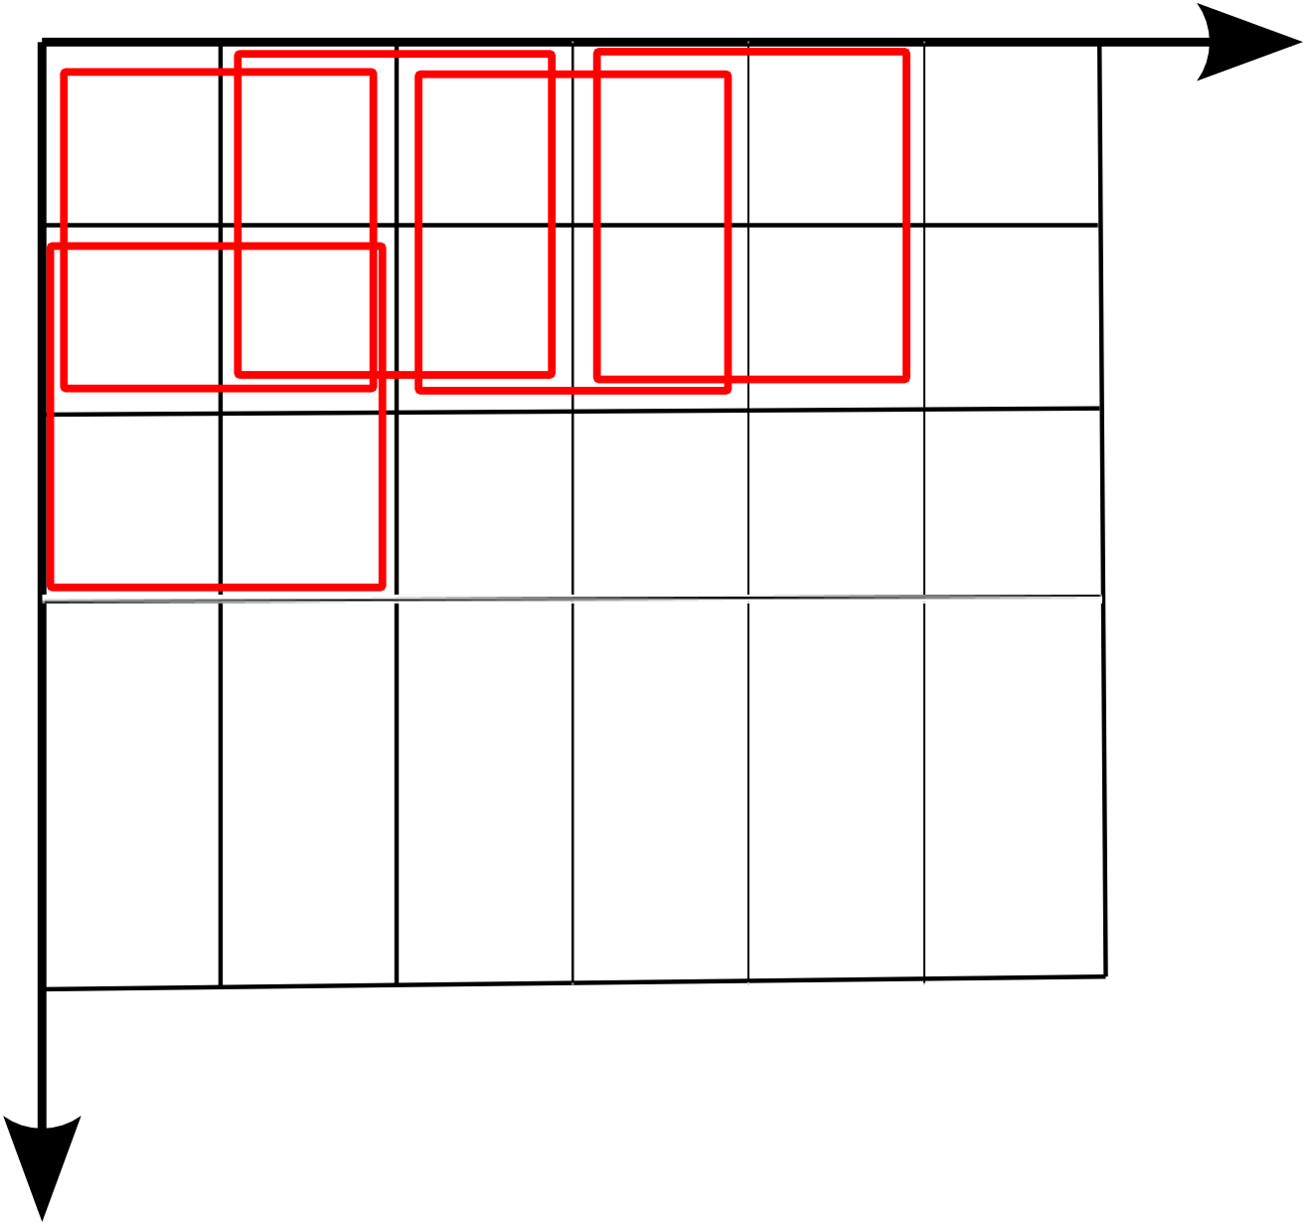
Histograms of Oriented Gradients (HoG) feature (Applied to detection window)
Divide the detection window into 8 x 8 pixels non-overlapping cells.
Divide the detection window into 16 x 16 pixels overlapping (8 pixel stride) blocks covering 2 x 2 cells.
Block
Blocks
Cell
Notes:
Left figure: Notice that each cell is 4x4 pixels for illustration
A Block is similar to a SIFT descriptor, except that it is smaller
Four blocks cover each cell (except at borders we need a wider border)

Slide 11
Histograms of Oriented Gradients (HoG) feature (Applied to detection window)
In each cell:
Compute a 9-bin gradient orientation histogram for the range (different from SIFTs range of )
Use gradient magnitude weighting and linear interpolation in neighbor bins (just as in SIFT).
Use a Gaussian window function centered on the block to weigh gradient magnitude contributions to histograms as a function of distance to block center (just as in SIFT).
Notes:
Ignore orientation sign (make a drawing of equivalent vectors)

Slide 12
Histograms of Oriented Gradients (HoG) feature (Applied to a detection window)
For each block:
Concatenate cell histogram vectors to a feature vector
Normalize feature vector:
Euclidean:
Peak clipping followed by renormalization (just as in SIFT)
For detection window:
Concatenate block feature vectors to form a joint feature vector for whole of detection window
Dimensionality for 64 x 128 = 8192 pixels detection window: 9 bins x (7 x 15) blocks = 945 dimensions
Apply a classifier to the joint feature vector – the detection window feature (Dalal & Triggs uses a linear Support Vector Machine (SVM))
Notes:
Epsilon to avoid zero gradients in flat image regions. This is an issue for dense approaches usually not for interest point based approaches (except for maybe MSER)
Peak clipping = hysteresis
After normalization each cell contributes to 4 blocks (normalization over a bigger area)
More on classifiers in StatML, but we can think of it as learning a filter for the detection window feature

Slide 13
HoG features visualized (Linear SVM)
Notes:
From left to right:
Average gradient image over all training images (a “ghost” of the training set)
Maximum positive SVM weights per block (most likely pedestrian)
Minimum negative SVM weights per block (most likely non-pedestrian)
Test image
HoG (for each block accumulate the 4 cell histograms)
And g) HoG weighted by SVM positive / negative weights (positive and negative class)

Slide 14
More human-friendly visualization of HoG
Vondrick et al 2013
Notes:
This is what HoG sees
Reconstructions from the HoG features

Slide 15
Dense feature template approaches
Training:
Extract features on localized object examples
Train a classifier to discriminate between object categories and background category
Query image:
Apply the classifier to a detection window
Slide the detection window across the image at all positions and scales
Reduce nearby matches to avoid double detections (non-maxima suppression)
Notes:
Train classifier on images of the size of detection windows with known labels. Both human and non-human examples must be given.
Training done at fixed scale / window size. Query at multiple scales.

Slide 16
HoG results on detecting humans
Notes:
Two datasets: MIT and INRIA
Miss rate: 1-recall = FalseNeg / (TruePos + FalseNeg) : Lower values are better. We do not want to miss any positives because there are fewer of these than negatives. See confusion matrix.
Results: HoG (Lin. R-HoG) with a regular grid does better than previous methods and other HoG variants for this problem. By tweaking HoG one can get slightly better performance (read the paper for details)

Slide 17
Confusion matrix revisited
Receiver operating characteristic (ROC):
TPR = TP / P (Recall)
FPR = FP / N
Miss rate:
1-recall = FN / P
False positives per window tested:
FPPW = FP / (P+N)
From Wikipedia 2012
Notes:
Confusion matrix: Summary of frequencies of different types of errors performed by the classifier.
TPR (True Positive Rate): Sensitivity or Recall. Ratio between true positives and all positives. Perfect classifier TPR = 1.
FPR (False Positive Rate): 1-specificity. Ratio between false positives and all negatives. Perfect classifier FPR = 0.
Random guess: Equal amount of False positives and False negatives errors.
As we vary r we get a curve (Draw example on whiteboard).

Slide 18
HoG results on detecting humans
Notes:
Two datasets: MIT and INRIA
Miss rate: 1-recall = FalseNeg / (TruePos + FalseNeg) : Lower values are better. We do not want to miss any positives because there are fewer of these than negatives. See confusion matrix.
Results: HoG (Lin. R-HoG) with a regular grid does better than previous methods and other HoG variants for this problem. By tweaking HoG one can get slightly better performance (read the paper for details)

Slide 19
Problems
This approach:
Not robust to occlusions – e.g. body parts being partially hidden, or intra-class variation.
Not robust to rotations, e.g. a rotation of the object in the image plane.

Slide 20
Part based models
Objects consist of parts which can help resolve partial occlusion.
Being able to detect parts can provide cues about the presence of an object (feedback loop).
Parts allow us to generalize models to handle large intra-class variation.

Slide 21
Deformable Parts Model (DPM) by Felzenszwalb et al CVPR 2008 & IJCV 2010
Deformable parts model consists of:
A root filter (HoG)
Parts models (HoG at higher resolution)
Spatial parts placement model within root filter (a quadratic cost function per part)
Notes:
The parts model is at twice the resolution of the root filter (A HoG pyramid implementation)
Parts can move around inside and outside the root filter as long as they overlap the root filter.
Placement model: Bright means that it is a good place to position the part.
Example show a person model (right) and an example of detection with this model (left).

Slide 22
Multi-scale detection in DPM
Notes:
Root filter at coarse scale
Parts filter at finer scale

Slide 23
Deformable Parts Model (DPM) by Felzenszwalb et al CVPR 2008 & IJCV 2010
Detection by filtering HoG pyramids
Apply filter across the HoG pyramid and compute Score(x,y,l) = Root + Parts – Deformation cost
Notes:
Score: Root and part filter responses (parts positions are optimized for score). A filter for root and per part.
Maximize the score over parts placement.
Number of parts must be fixed! Felzenszwalb uses 6 parts.

Slide 24
Deformable Parts Model (DPM) by Felzenszwalb et al CVPR 2008 & IJCV 2010
Filters and parts displacement parameters are learnt with a SVM classifier using latent variable SVM classifier
Notes:
The classifier is simply the dot product between filters and HoGs and displacements models. This is equal to the score.
Positive output of classifier means a detection for this location in the image pyramid.
A root filter and n parts filters.
Dot product represents the score
Z is the latent variable representing parts placements – we maximize the score over these.
Latent SVM iterative learning procedure:
Fix parts placement z and we have a linear SVM in beta – train this
Fix beta and train for optimal z

Slide 25
Root classifier similar to original HoG
Notes:
The learnt root filter or one part filter could look like this:
Maximum positive SVM weights (positive class)
Minimum negative SVM weights (negative class)
And g) HoG weighted by SVM max/min pos/ neg weights

Slide 26
Visualization of some DPM parts features
car
person
bottle
bicycle
motorbike
potted plant
train
bus
horse
television
chair
Vondrick et al 2013

Slide 27
DPM results
Notes:
Pretty robust towards changes in view point, scale and illumination
Some failures: School bus under cars, cow and plane part under horse.

Slide 28
DPM results
Notes:
Has problems with rotations – Notice the missed upside down bottle in second row first image.
Has problems with some occlusion: Notice the missed bottles in the back of image in second row first image.
Arm chair confused with sofa is maybe ok (hard negative example). The two cats have a layout as a sofa – not ok.

Slide 29
Hard negative examples for person detector
Felzenszwalb et al propose a learning strategy to improve performance of this type of examples.
Notes:
The cow is a hard negative example because we see two legs, head and shoulders.
The learning strategy is to concentrate on the hard negative examples instead of all negative examples.

Slide 30
Visualization of the cause of failure
Vondrick et al 2013
Notes:
But we still get false detections like this one.
Maybe reasonable when we see what HoG sees?

Slide 31
Do you see the same objects as DPM?
Vondrick et al 2013
Notes:
DPM gave the first rows of detections – do you agree with the labels?
Row 3-4: They are all examples of false detections
Conclusion: HoG is blind to some kinds of structures (higher order structure).

Slide 32
Other approaches in object recognition / detection
Bag of visual words together with interest points
Shape features (instead of only texture / local structure)
Object taxonomies (e.g. using language resources such as WordNet – a database of cognitve synonyms)
Domain specific knowledge (e.g. taxonomy of flower or bird species)

Slide 33
Summary
For object detection and recognition we can use:
Interest point based approaches (can be extended to bag of visual words)
Dense feature template approaches
Parts models
Dense feature template approaches:
Histogram of Oriented Gradients (HoG)
Deformable parts models (DPM)
HoG captures first order structure locally and encodes higher order structure through cell grid. Maybe we can do better?

Slide 34
Literature
Reading material:
Everingham et al IJCV 2010 (State of the art)
Dalal & Triggs (CVPR’05) (HoG details)
Felzenszwalb et al CVPR 2008 (DPM details)
Or
Felzenszwalb et al IEEE T-PAMI 2010 (DPM details)
Additional material:
Vondrick et al (ICCV 2013) (Visualizing HoG and DPM)

